Slide 1
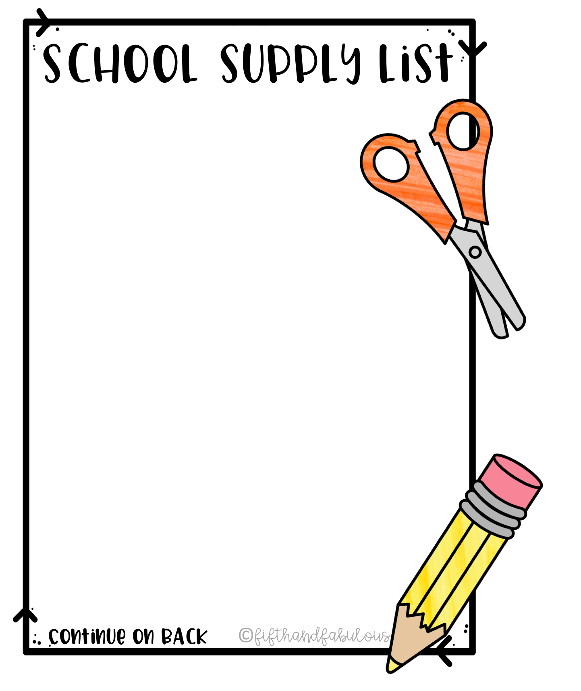
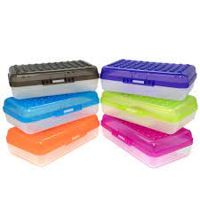
Mrs. Herppich’s Kindergarten
**These items are suggested.. Please do NOT label items with
child’s name unless indicated**
Change of clothes (include underwear and socks, put in ziploc
bag labeled with child’s name, keep in backpack all year)
1 Large Backpack (to fit papers, lunchbox, shoes in winter, labeled with child’s name)
1 pair of headphones to use with your child’s school-issued iPad (label headphones with your child’s name)
12 sharpened pencils (Ticonderoga brand hold up best)
2 bottles Elmer’s white school glue (4 oz.)
2 packs of Elmer’s glue sticks (4-6 in a pack)
2 boxes Crayola crayons (24 count)
1 box Crayola markers (8 Classic Colors)
1 box Crayola colored pencils (12 count)
1 pair Fiskar’s brand blunt-tip student scissors
1 set Crayola Watercolor Paints (8 colors)
2 Fine Tip Black Expo dry erase markers
2 boxes of tissues
1 pack Paper Mate pink erasers
1 rectangular plastic pencil box (as pictured, labeled with name)
1 package napkins
1 pack/container baby wipes
1 box of gallon size OR quart size storage bags
Please put all supplies (except backpack, headphones, spare clothes and water bottle) in a large bag, labeled with child’s name, and send the first week of school. I will help your child organize his/her items at school. ☺

Slide 2
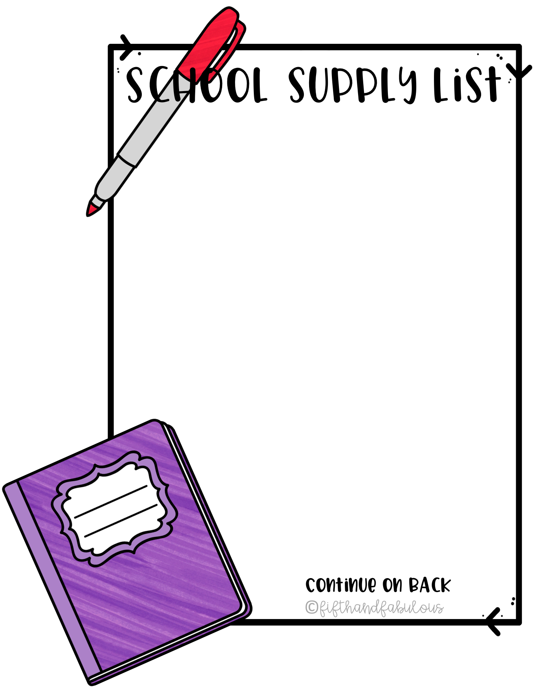
Bring the following items DAILY:
CHARGED iPad (this will be loaned to your child by the school)
Headphones for iPad (labeled with child’s name)
Backpack (labeled with child’s name, and spare clothes packed inside)
Reusable Water Bottle (labeled with child’s name)

